Slide 1
DataLogger For Android
based on Cosm.com
Presented by: Pang Zineng

Slide 2

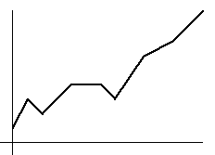



What it does?
Environment
Data
Diagram
[Share]
[Share]
[Share]
Your World
(a Feed)
(a Picture)

Slide 3
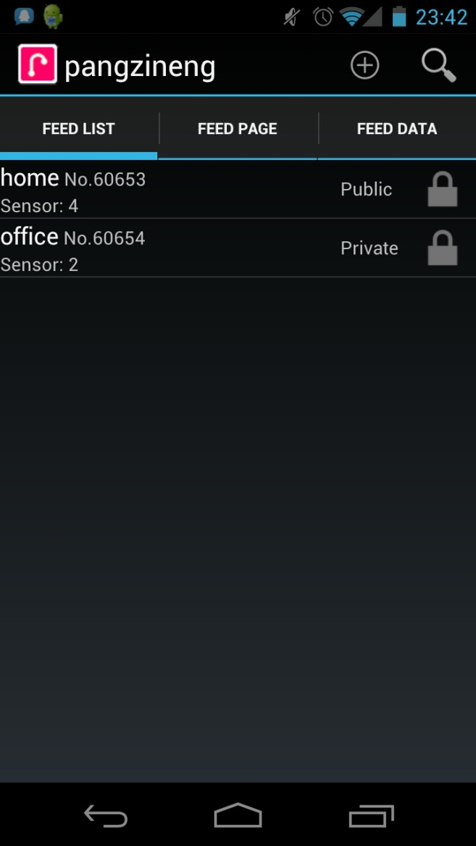
How it works?
The User
User
0..*
Feed
All feeds from this user
0..*
Data
1
Diagram

Slide 4
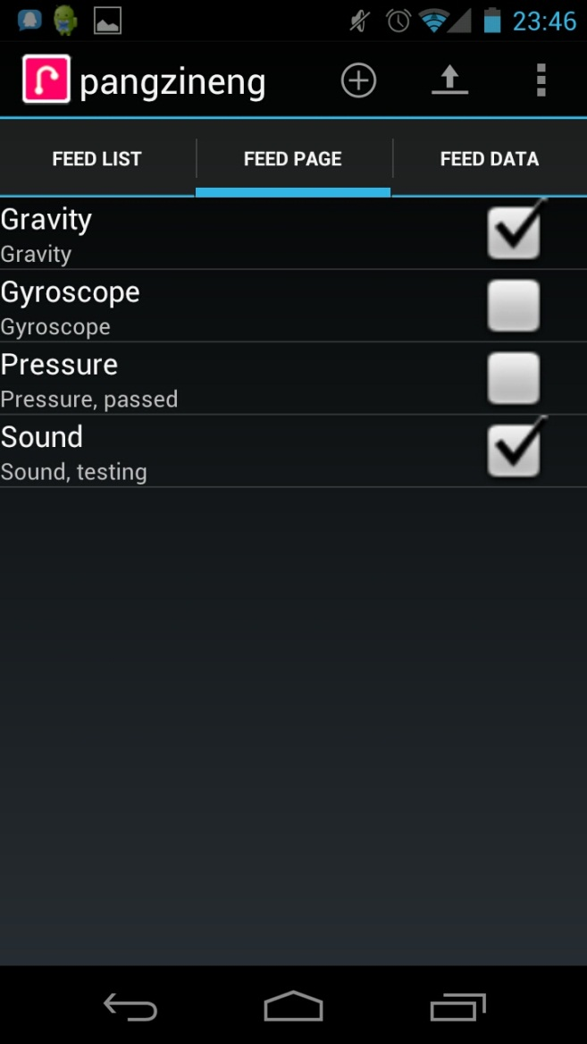
How it works?
User
0..*
Feed
0..*
Data
All data from this feed
1
Diagram

Slide 5
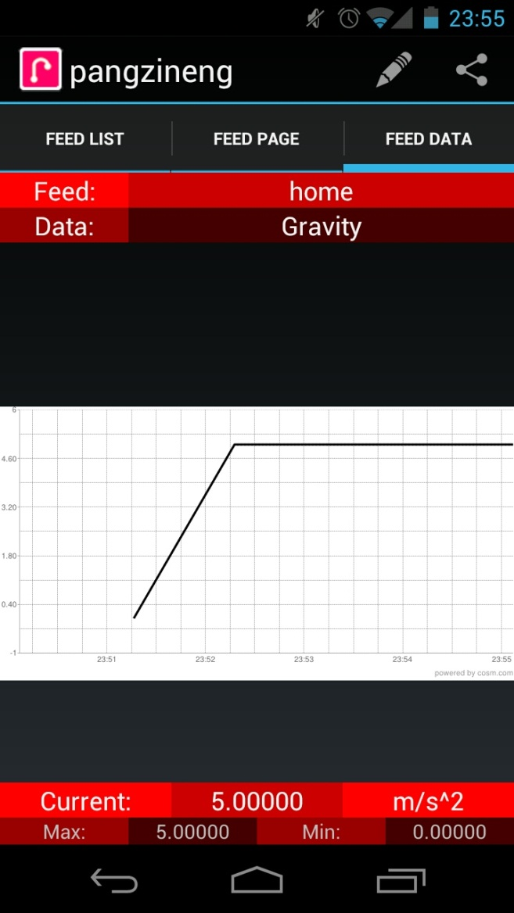
How it works?
User
0..*
Feed
0..*
Data
1
Diagram
The diagram of this data

Slide 6
Structure
User Interface
Notification
Controller
Lightweight Controller
C
C
C
Cache
Database
Cosm
C
C
C
External
Hardware
Service

Slide 7
What is inside the components?
Cache
Database
Cosm
External
Hardware
Service

Slide 8
What is inside the components?
Cache
SharedPreferences
External
LocationManager, Email app, Downloader
Database
SQLite (built-in)
Hardware
Device Info, Network, MediaRecorder, Sensor
Cosm
HTTP, Cosm API (based on JPachube)
Service
NotificationManager, Services

Slide 9
How different components run
Procedure of Creation
Create data
Update data
Share data

Slide 10
Procedure of Creation
Database
Create one feed
Database
Create one data
Database
Sensor table exists
Hardware
N
Scan for available sensors
Y
Database
Database
Save sensors info
Load and display sensor list
Create data
Cosm
Database
Save the new data

Slide 11
Procedure of Update
Service
Background Service running
Hardware
Get new data
Hardware
Internet connected
N
Y
Database
Database
Save new data
Offline data exists
N
Y
Cosm
Upload offline data
Cosm
Upload new data
Service
Update notification

Slide 12
Procedure of Sharing
Database
Enter one Data
Cosm
Download diagram and statistic
External
Hardware
Display diagram
Cache
Email app exists
External
N
Y
External
fails
Share diagram via email
Cache

Slide 13
Q & A
If any…

